Slide 1
Modeling Effect of Lockdowns and Other Effects on India Covid-19 Infections Using SEIR Model and Machine Learning
Paper 40
SOCPAR 2021
Sathiyanarayanan Sampath, Joy Bose
Ericsson Bangalore

Slide 2
Problem Statement
The susceptible-exposed-infectious-recovered (SEIR) model is a widely used epidemiological model used to predict the rise in infections. It has been widely used for modelling Covid-19.
Original SEIR model does not take into account the effect of factors such as lockdowns, vaccines, and re-infections.
We look at modifying the SEIR model to account for these factors
Validation: We then apply the modified model to Covid-19 infections in second wave in India (April - June 2021)

Slide 3
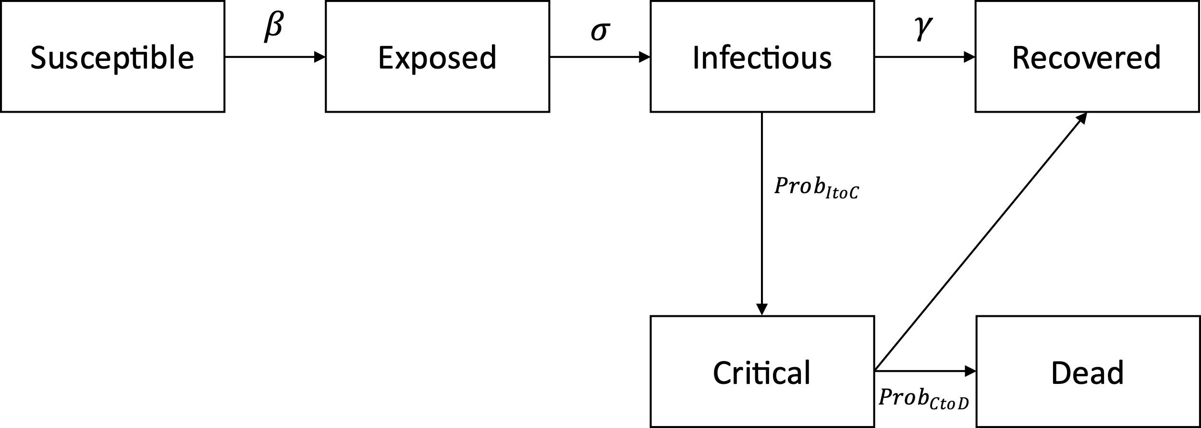
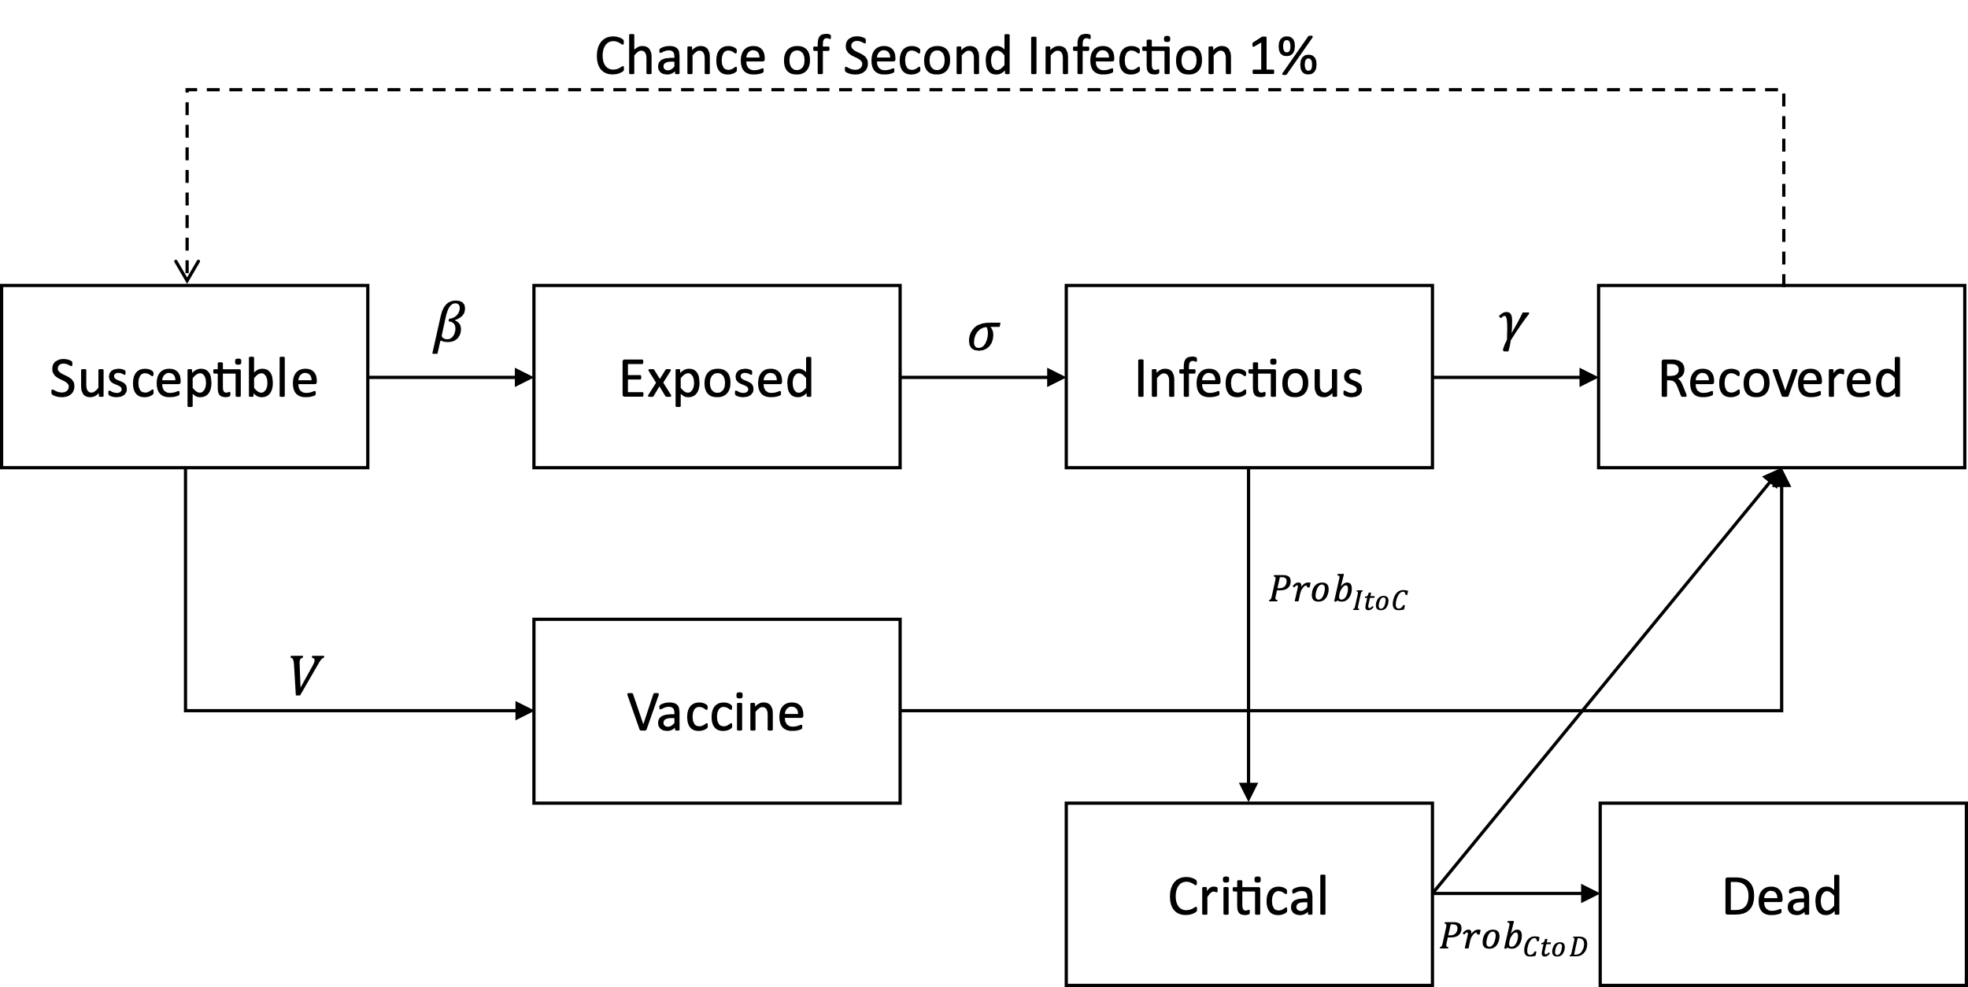
SEIR model: original and modified
1. Original SEIR model
2. SEIR model with critical cases and deaths
3. Modified SEIR model with re-infections and vaccines

Slide 4

Original SEIR equations
$\frac{dS}{dt}=\frac{−βIS}{N}$
$\frac{dE}{dt}=\frac{βIS}{N}− σE$
$\frac{dI}{dt}=σE− 1/{12.0∗Prob_{ItoC}∗I−γ\left(1−Prob_{ItoC}\right)∗I}$
$\frac{dC}{dt}=1/{12.0} ∗Prob_{ItoC}∗I− 1/{7.5}∗Prob_{CtoD}∗\min\left(Beds, C\right)−\max\left(0, C−Beds\right)−\left(1−Prob_{CtoD}\right) 1/{6.5}∗min⁡(Beds−C$
$β= γ∗ R_{0}$
$\frac{dR}{dt}=γ\left(1−Prob_{ItoC}\right)∗I+ \left(1−Prob_{CtoD}\right) 1/{6.5}∗\min\left(Beds−C\right)$
$\frac{dD}{dt}=1/{7.5}∗Prob_{CtoD}∗\min\left(Beds, C\right)+max⁡(0, C−Beds)$
$R0= \frac{{R0}_{start }−{R0}_{end}}{\left(1+ e^{−k∗\left(−t+t0\right)}\right)}+ {R0}_{end}$

Slide 5

Modified SEIR for lockdowns
We have modified the SEIR equations to have R0 as a function of time to depict real world scenario. We have defined R0 with smooth rectangular function, which is continuously differentiable, which stays low when there is no spread, gradually in-creases when spread is high and stays high for some time and come back to low values when things are back to normal.
We consider the effect of two different waves of Covid-19 (such as for India):
$R0= {R0}_{Wave1}+{R0}_{Wave2}$
${R0}_{Wavei}= \frac{{R0}_{start }−{R0}_{end}}{\left(1+ e^{−k∗\left(−t+ai\right)∗\left(−t+ai+bi\right)}\right)}+ {R0}_{end}$
$R0= \frac{{R0}_{start }−{R0}_{end}}{(1+ e^{k∗\left(−t+a1\right)∗(−t+a1+b1)})}+ {R0}_{end}$
Here, k defines the smoothness of the curve, a1 & b1 defines the start and end of the curve. R0-start and R0-end defines the max and min values of the curve.

Slide 6
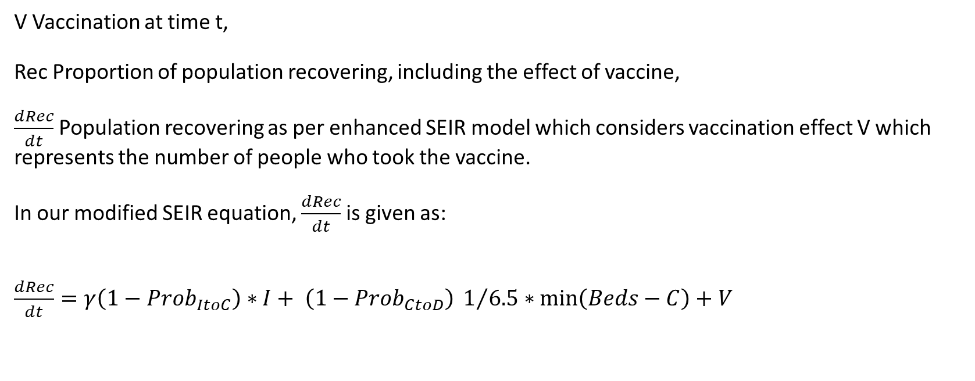
Modified SEIR for vaccination
V Vaccination at time t,
Rec Proportion of population recovering, including the effect of vaccine,
$\frac{dRec}{dt}$ Population recovering as per enhanced SEIR model which considers vaccination effect V which represents the number of people who took the vaccine.
In our modified SEIR equation, $\frac{dRec}{dt}$ is given as:
$\frac{dRec}{dt}=γ\left(1−Prob_{ItoC}\right)∗I+ \left(1−Prob_{CtoD}\right) 1/{6.5}∗\min\left(Beds−C\right)+V$

Slide 7
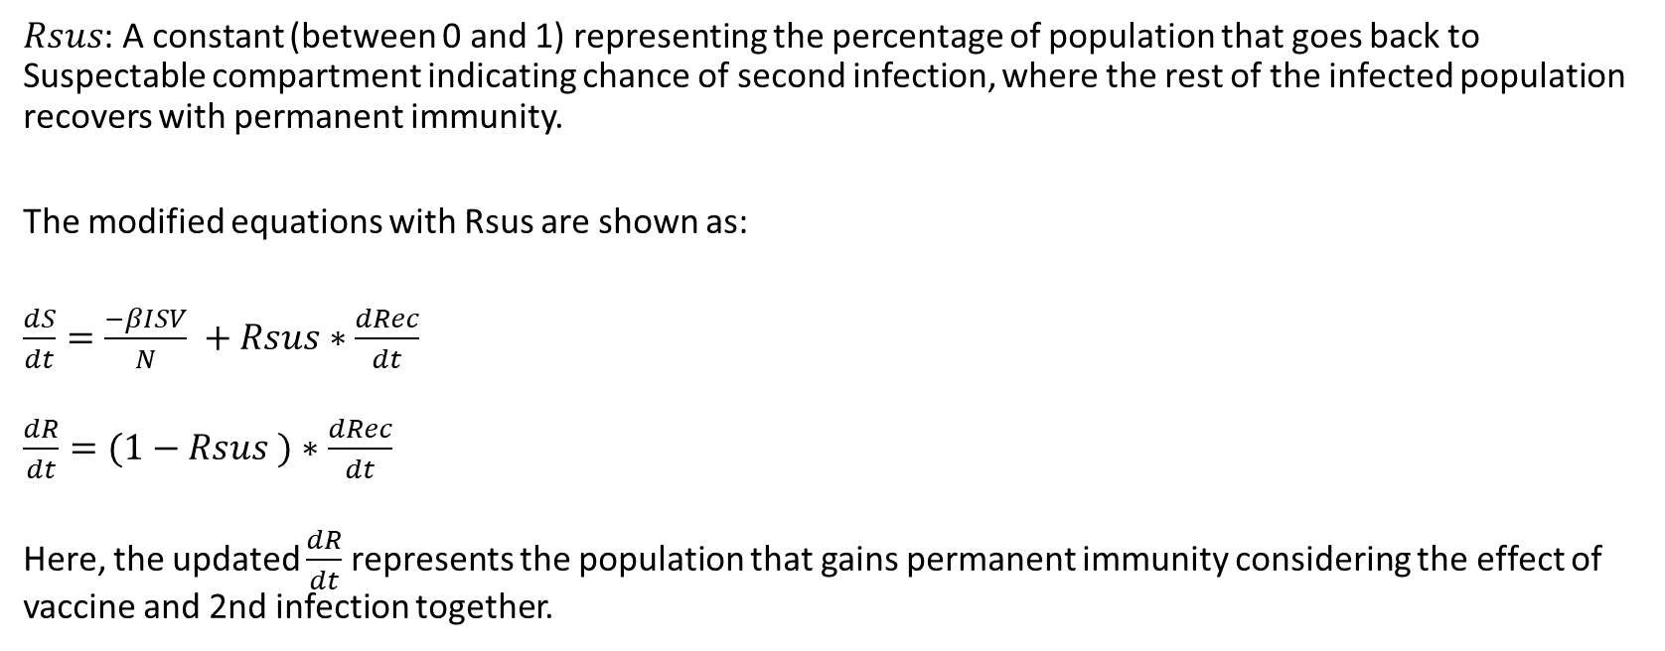
Modified SEIR for second infections
$Rsus$: A constant (between 0 and 1) representing the percentage of population that goes back to Suspectable compartment indicating chance of second infection, where the rest of the infected population recovers with permanent immunity.
The modified equations with Rsus are shown as:
$\frac{dS}{dt}=\frac{−βISV}{N} +Rsus∗\frac{dRec}{dt}$
$\frac{dR}{dt}=(1−Rsus )∗\frac{dRec}{dt}$
Here, the updated $\frac{dR}{dt}$ represents the population that gains permanent immunity considering the effect of vaccine and 2nd infection together.

Slide 8
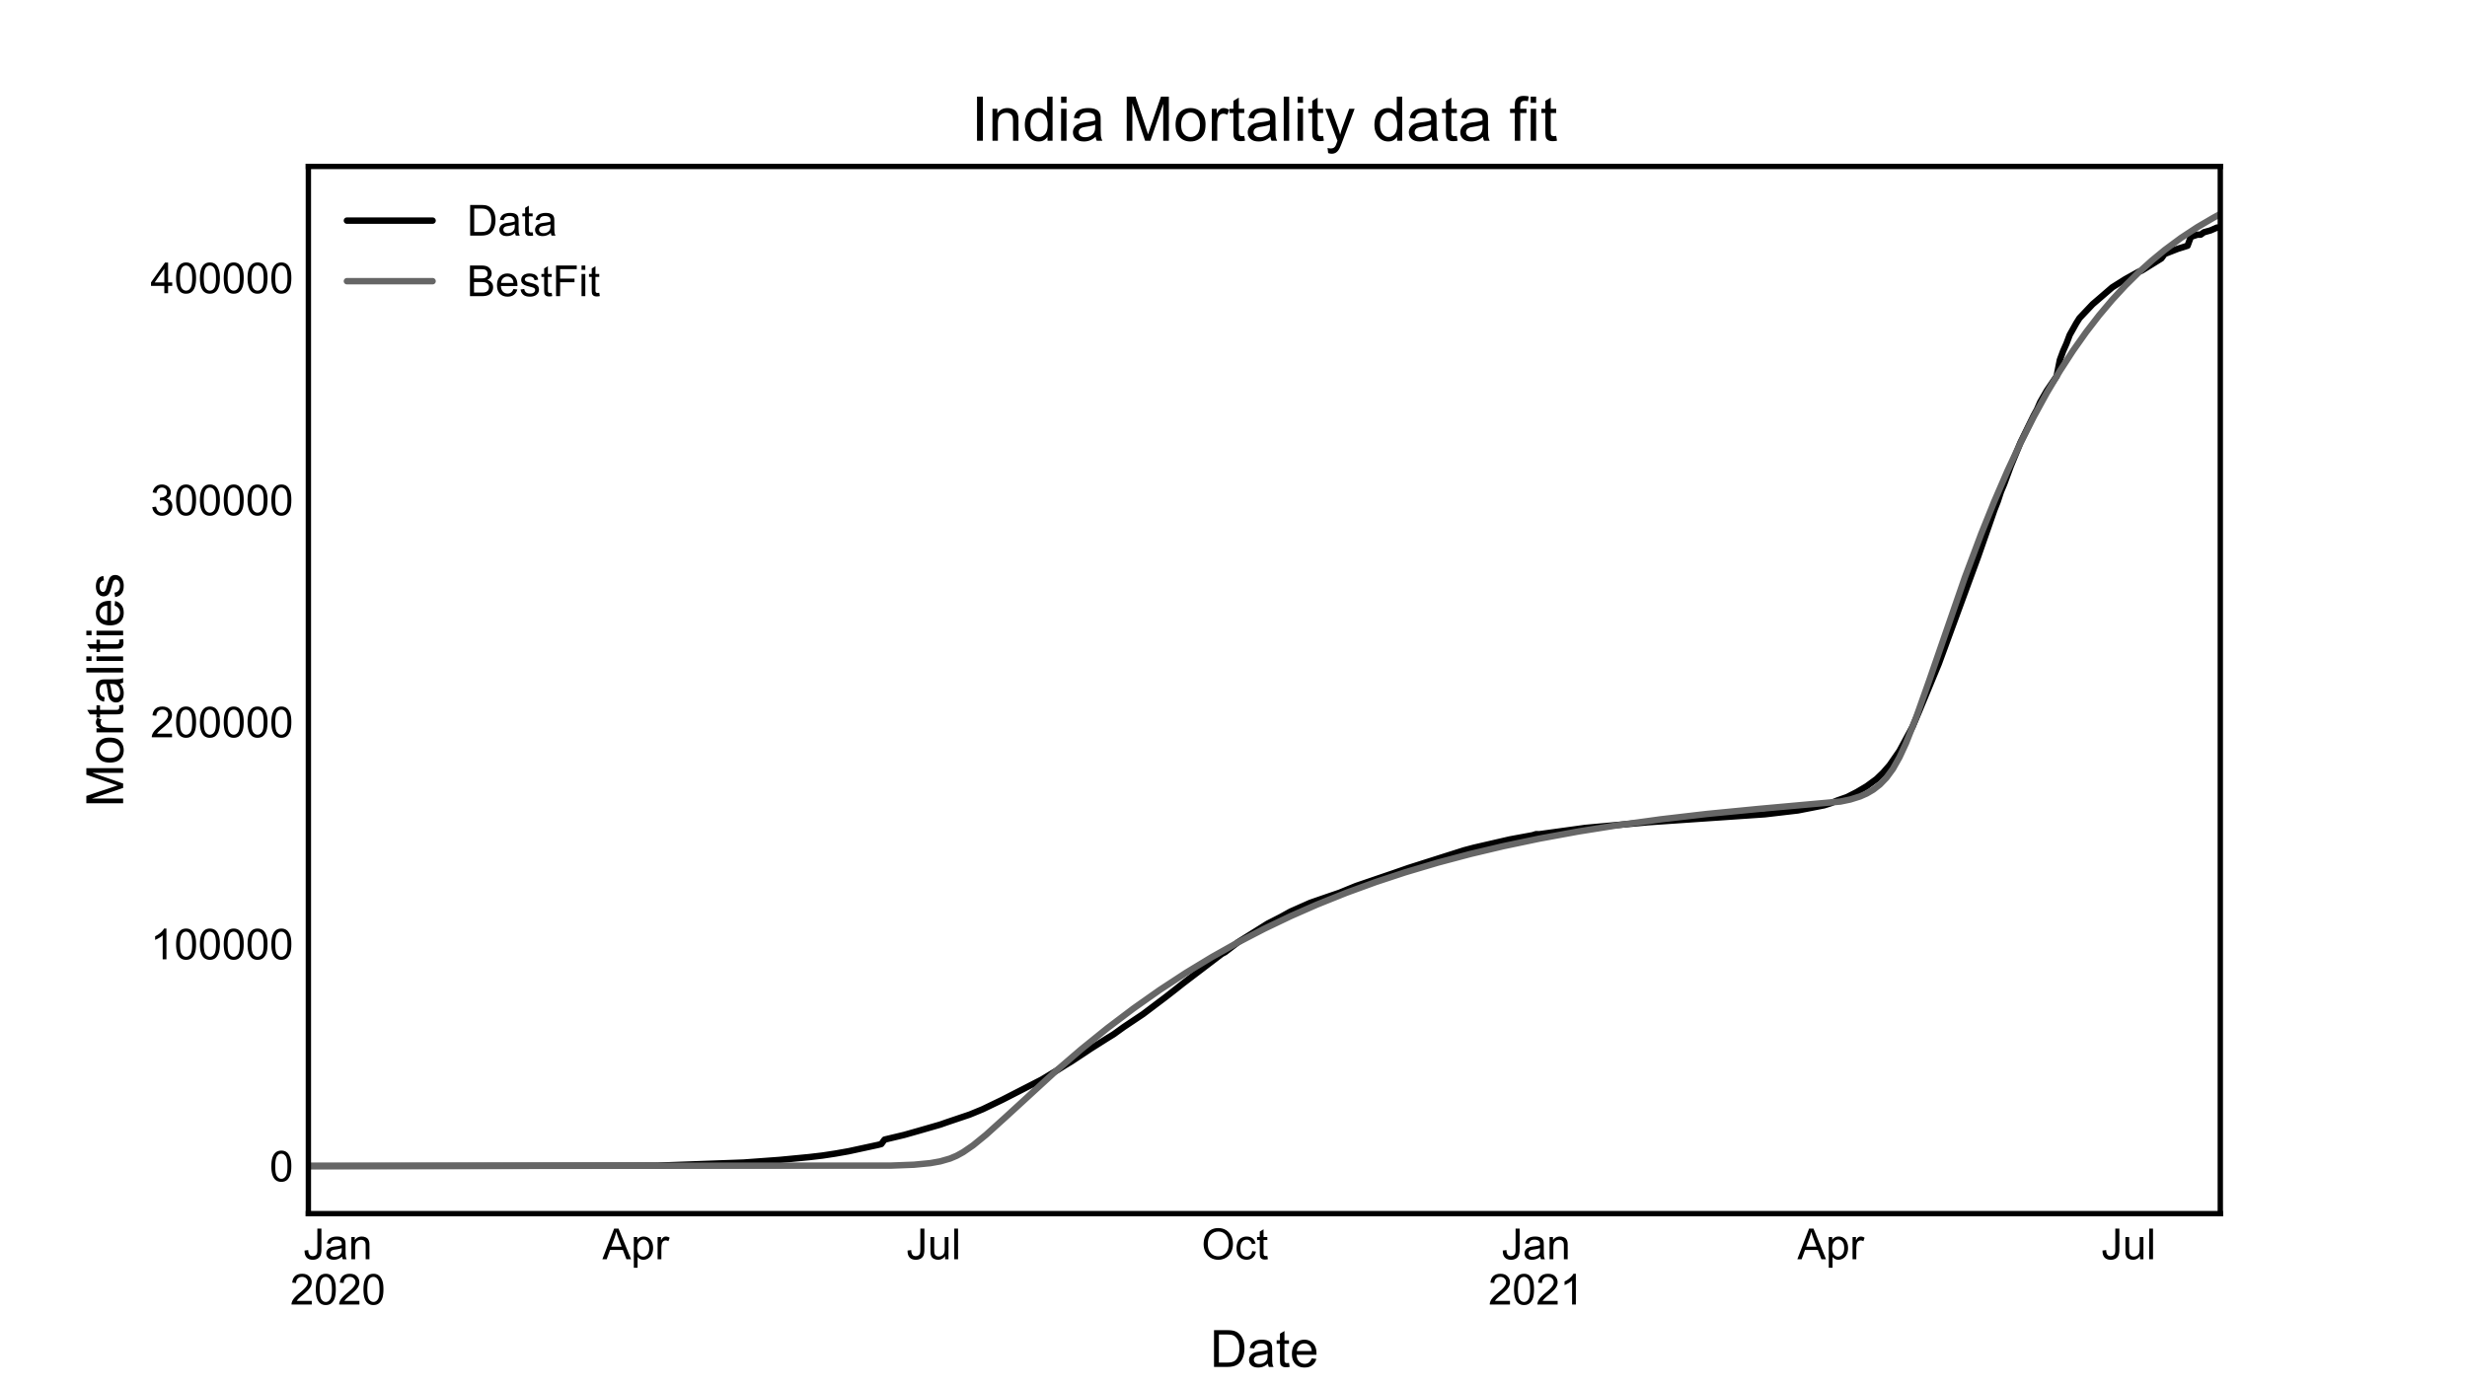
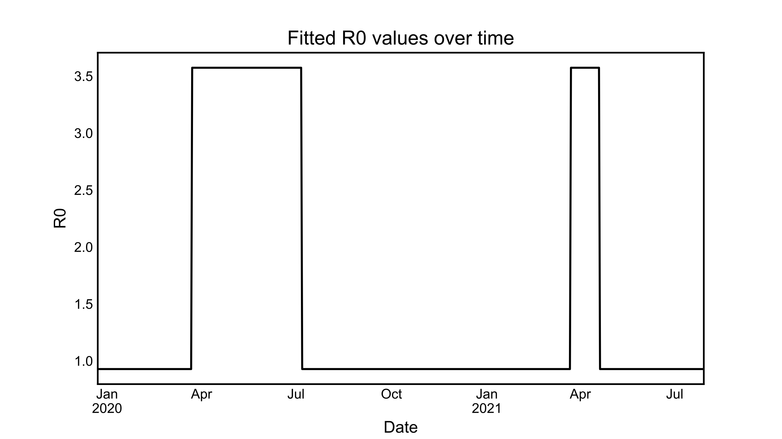
Datasets used and fit results
We have taken India Covid-19 data from John Hopkins dataset
We have taken Vaccination data from CoWin public APIs
Used lmfit (python lib for least squares minimization) to fit the data

Slide 9
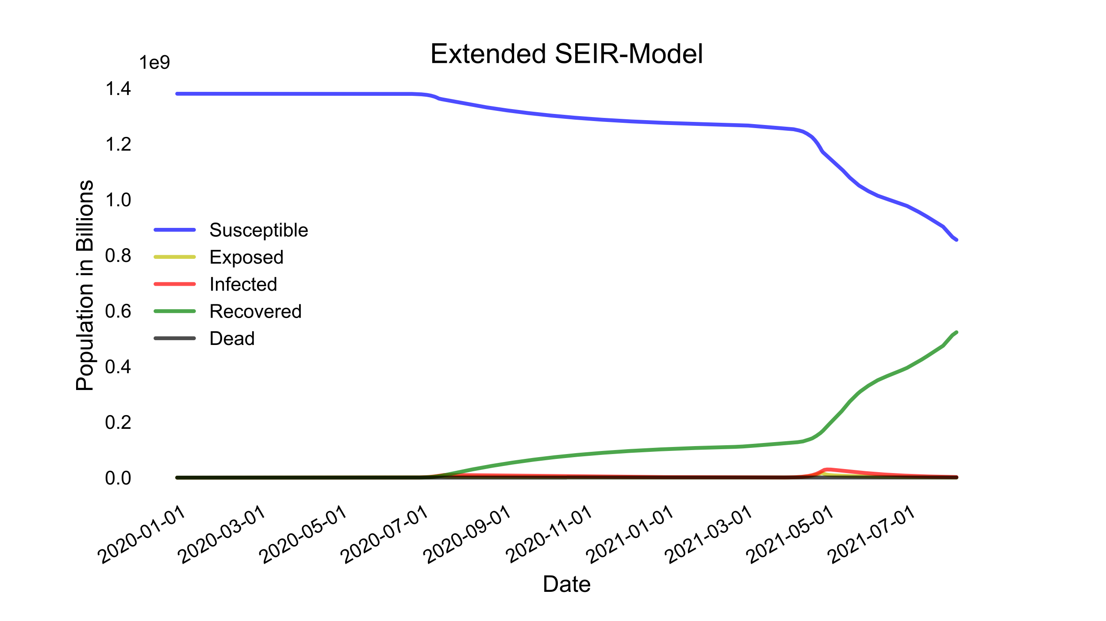
Results of curve fitting
Evaluation Metric | Value
R2 | 9.98e-01
Mean Absolute Error (MAE) | 2.98e+03
Mean Squared Error (MSE) | 2.23e+07
Root Mean Squared Error (RMSE) | 4.72e+03

Slide 10
Conclusion and future work
We have proposed a few modifications of the SEIR model to accurately model the numbers for the Covid-19 pandemic for India, considering factors such as lockdown, vaccines and second infections.
We have fitted our modified SEIR model with actual Covid-19 data for India and obtained good results.
In future, we plan to extend our approach with different models for curve fitting and other machine learning models for regression.
We also plan to implement the method for different states of India rather than taking India as a whole.

Slide 11
References
Our World in Data. Coronavirus Pandemic (COVID-19) – the data https://ourworldindata.org/coronavirus-data
Wikipedia. Compartmental models in epidemiology https://en.wikipedia.org/wiki/Compartmental_models_in_epidemiology
“Seasonality and period-doubling bifurcations in an epidemic model''. J.L. Aron and I.B. Schwartz, J. Theor. Biol. 110:665-679, 1984
Towards Data Science, Medium. Henri Froese. Infectious Disease Modelling: Fit Your Model to Coronavirus Data. April 2020 https://towardsdatascience.com/infectious-disease-modelling-fit-your-model-to-coronavirus-data-2568e672dbc7
Github. CSSEGISandData/COVID-19. https://github.com/CSSEGISandData/COVID-19/tree/master/csse_covid_19_data
APISetu. CoWin public APIs https://apisetu.gov.in/public/marketplace/api/cowin
Github.io. Non-Linear Least-Squares Minimization and Curve-Fitting for Python. https://lmfit.github.io/lmfit-py/
Pandey G, Chaudhary P, Gupta R, Pal S. SEIR and Regression Model based COVID-19 outbreak predictions in India. arXiv preprint arXiv:2004.00958. 2020 Apr 1.
He, S., Peng, Y. and Sun, K., 2020. SEIR modeling of the COVID-19 and its dynamics. Nonlinear dynamics, 101(3), pp.1667-1680.

